Slide 1
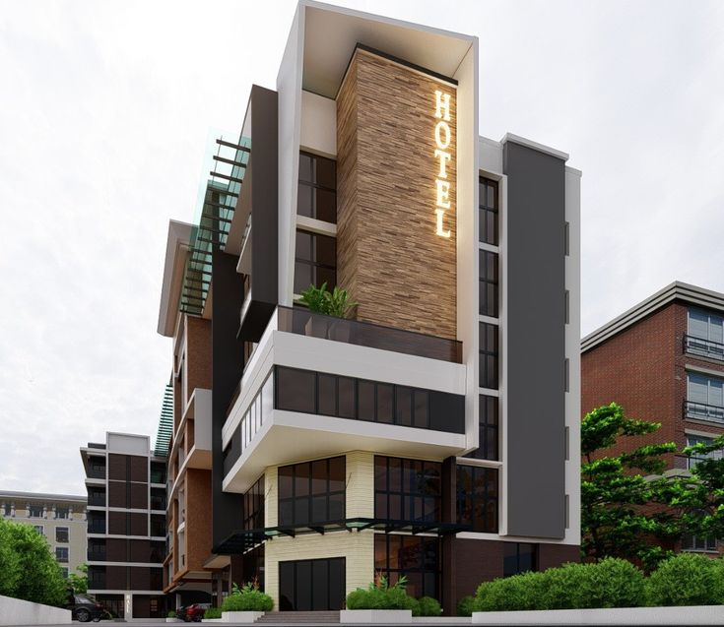
HOTEL REVIEW DATA ANALYSIS
BY GROUP: 2
JESHMA MARIA VEIGAS
GAURI PRAVIN DEGAONKAR
RUATFELA
PUSHPAK UMARE
PIYUSH PANDEY

Slide 2
Agenda
Business Problem
Project Flow
Data Summary
Data Pre-processing
Different Model Performance
Deployment
Conclusion

Slide 3

Problem Statement
Customer reviews on hotels are very important part of travel plan for people now a days. People prefer to book such hotels which have high number of positive reviews. There are diﬀerent sources to ﬁnd the reviews to get a better insight about the hotel’s reputation. Thus it can be said that customer reviews plays an important part for business owners in order to improve their services.
In this project, sentiment analysis is performed on the basis of user reviews using three diﬀerent classiﬁers. The classiﬁers used in this project are “Naive Bayes", "Random Forest” and “Support Vector Machine”. The performance of these algorithms are assessed on two diﬀerent parameter settings. The reviews are classiﬁed as “Positive", “Negative” labels.

Slide 4
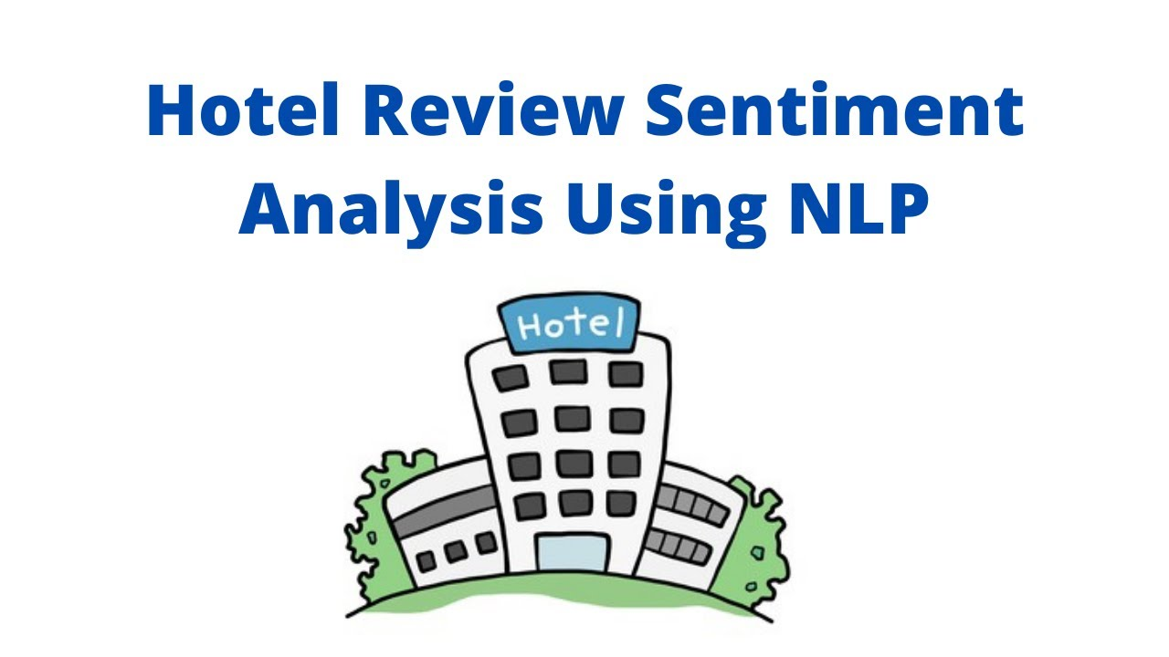
Objective:
Our goal is to examine how travellers are communicating their positive and negative experiences in online platforms for staying in a specific hotel and major objective is what are the attributes that travellers are considering while selecting a hotel. With this manager can understand which elements of their hotel influence more in forming a positive review or improves hotel brand image.

Slide 5
Project Flow
Data Input
Data workflow
Data Pre-processing
Exploratory Data Analysis
Training Various Models
Predicting Results and Selecting Best Model
Analysis and Conclusion
Deployment
RESULT

Slide 6
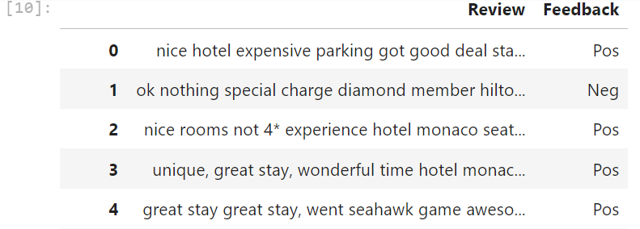
DATA SUMMARY
Dataset details:
The Dataset contains 20,491 rows and 2 columns.
The Dataset does not have duplicate or null values.

Slide 7
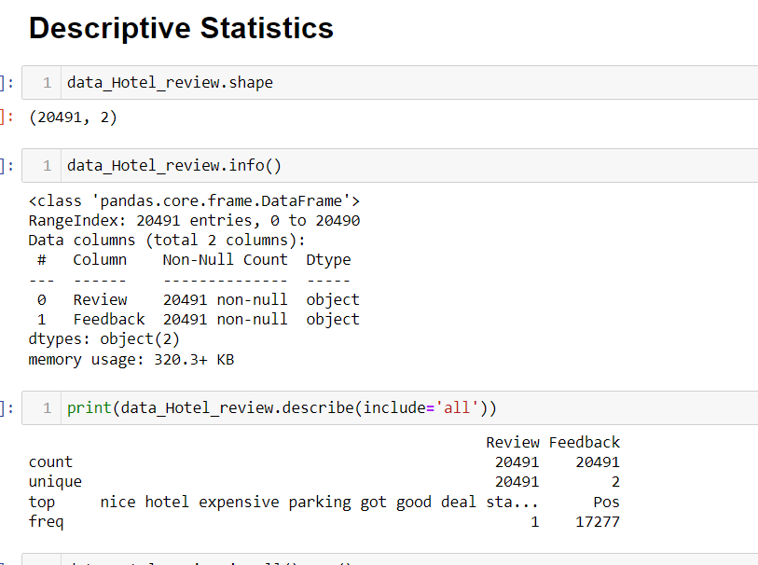
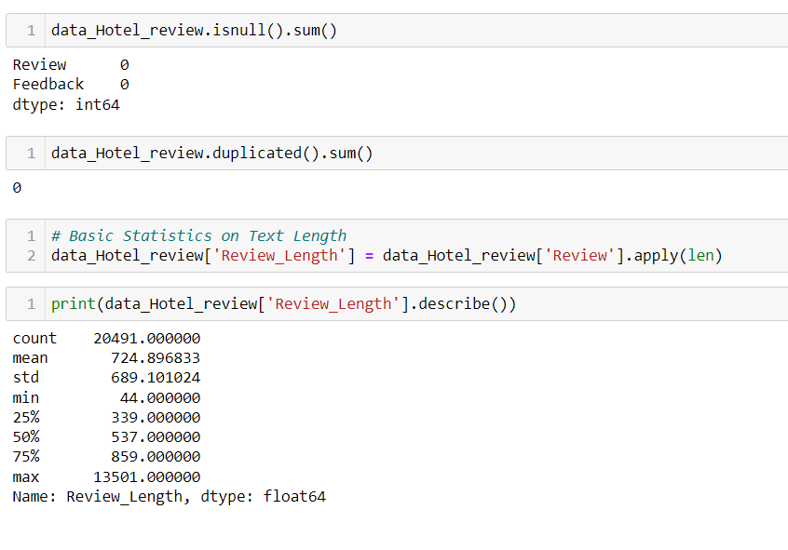
DATA PRE-PROCESSING

Slide 8
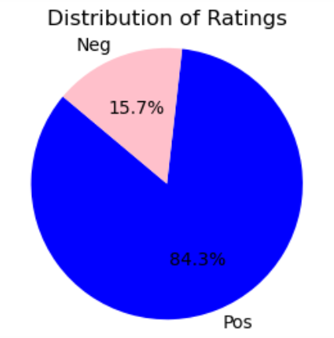
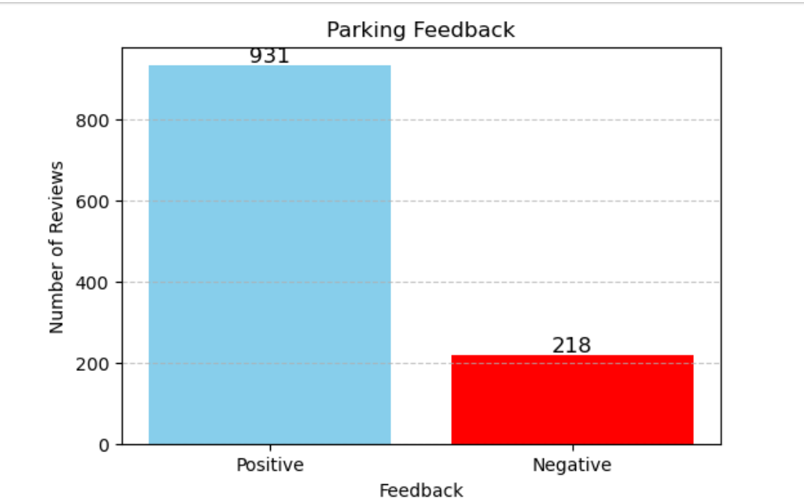
EXPLORATORY DATA ANALYSIS
1. DISTRIBUTION OF RATINGS
Customers overall positive experience: 84.3%
Customers overall negative experience: 15.7%
2.PARKING FEEDBACK
Positive feedback: 931
Negative feedback: 218

Slide 9
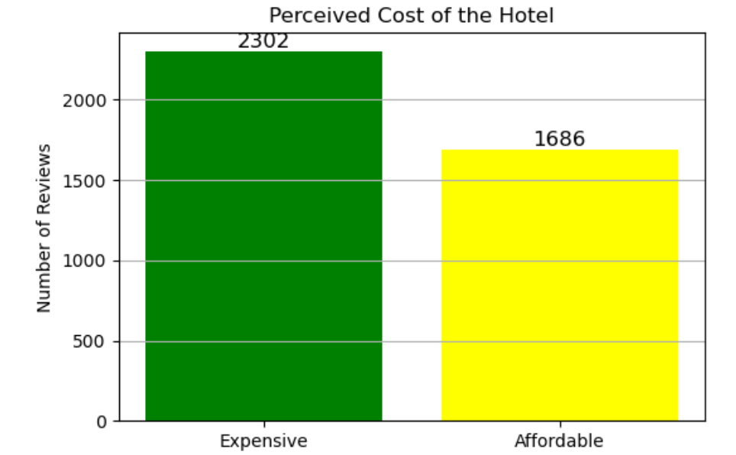
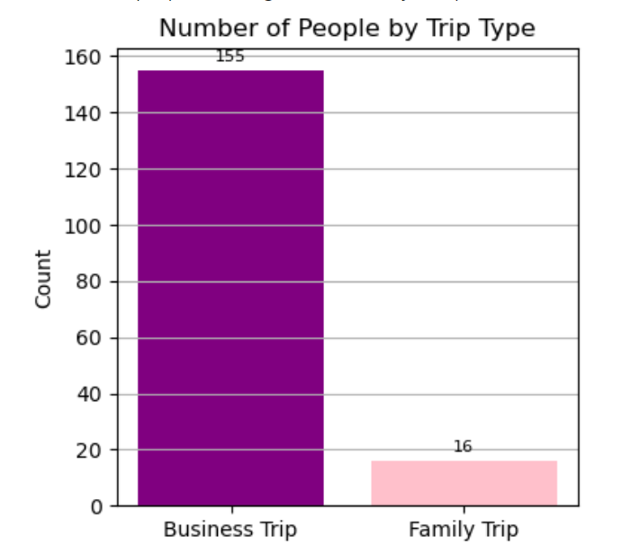
EXPLORATORY DATA ANALYSIS
3. EXPENSIVE VS AFFORDABLE
Experience feedback: 2302
Affordable feedback: 1686
4. FAMILY TRIP VS BUSINESS TRIP
Business Trip : 931
Family Trip : 218

Slide 10
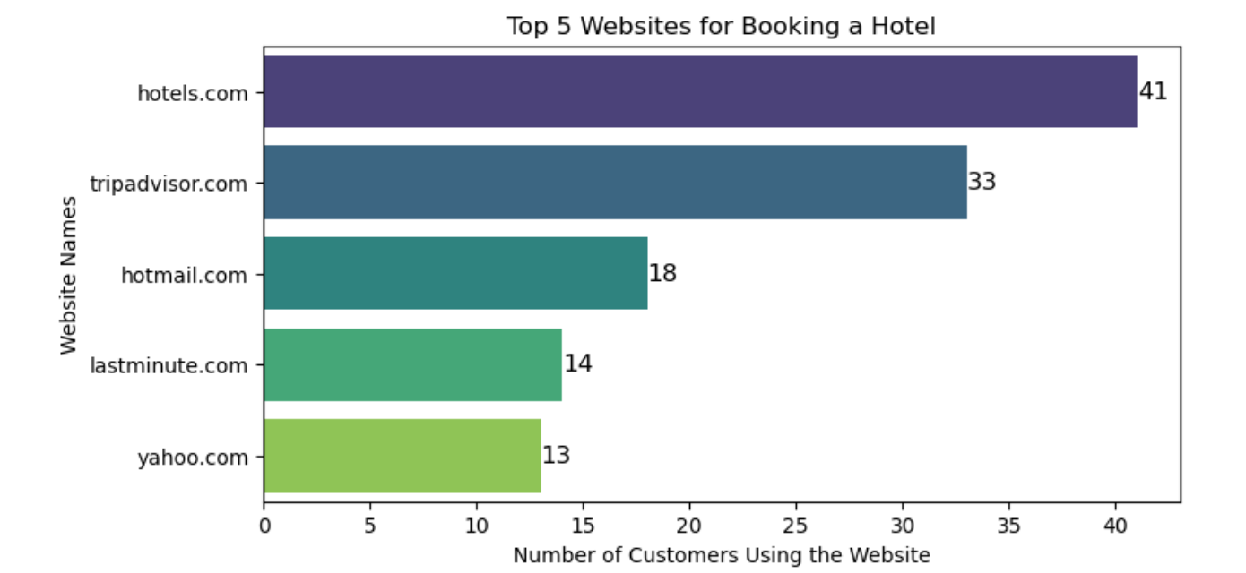
EXPLORATORY DATA ANALYSIS.
5. TOP 5 BOOKING SITES
Hotels.com and TripAdvisor.com were the top choices for booking hotels
Hotels.com : 41
Tripadvisor.com : 33

Slide 11
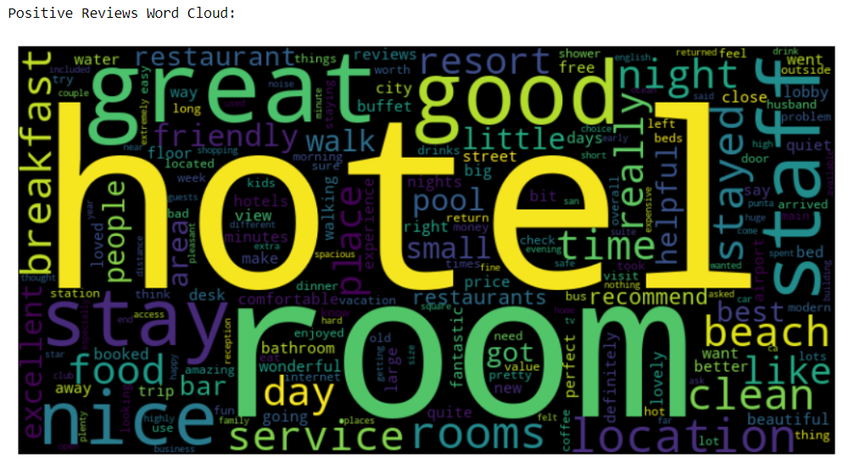
TEXT PREPROCESSING
WordCloud : Positive Reviews :
it shows hotel, night, room, good resort, place are more commonly used Postive words

Slide 12
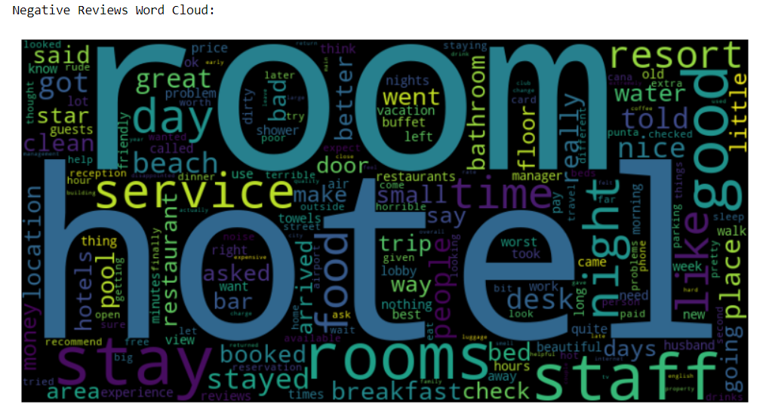
TEXT PREPROCESSING.
WordCloud : Negative Reviews:
It shows Room,hotel night, food,service,staff are most commly used negative words

Slide 13
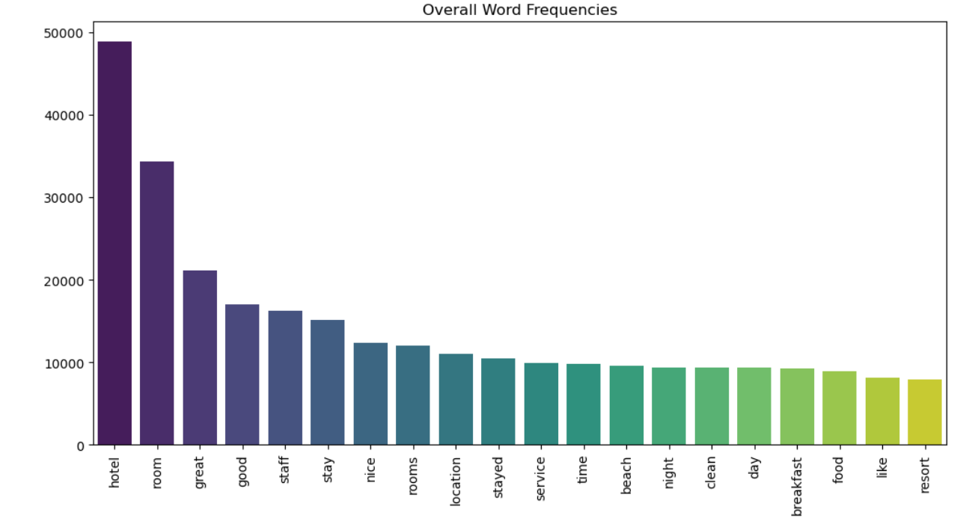
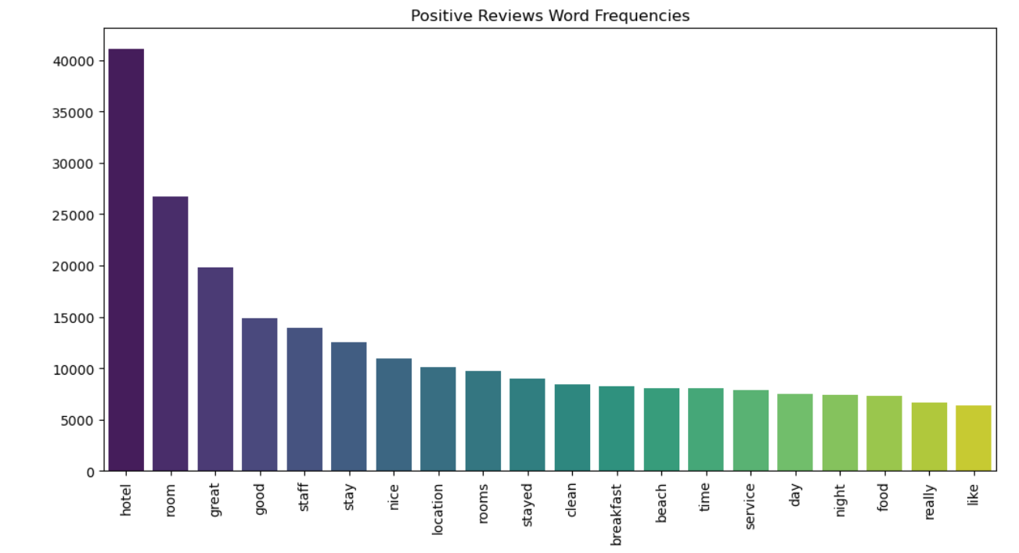
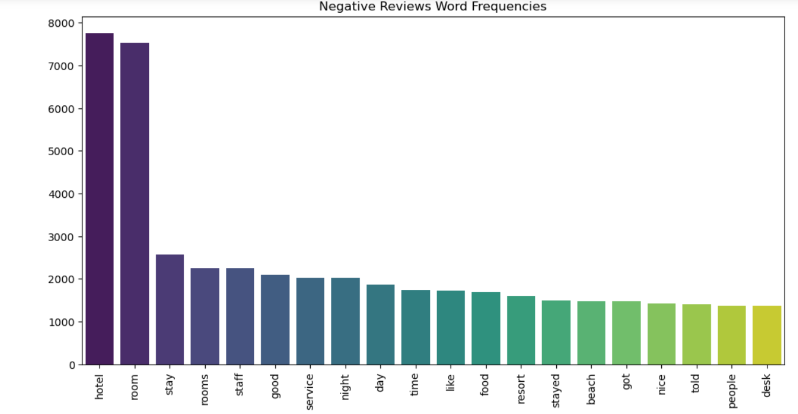
TEXT PREPROCESSING.

Slide 14
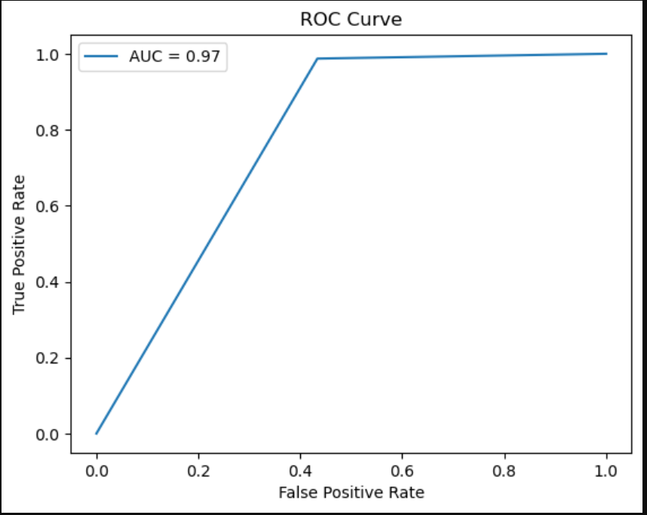
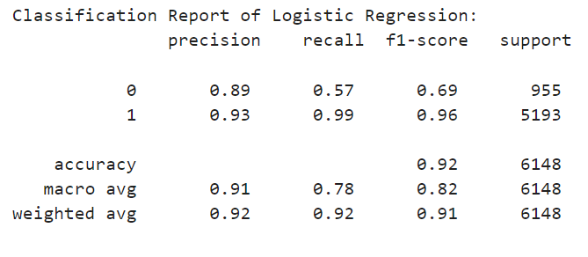
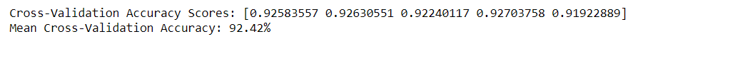
MODEL BUILDING
1.LOGISTIC REGRESSION
A statistical method that is used for building machine learning models where the dependent variable is dichotomous: i.e. binary.
Logistic regression is used to describe data and the relationship between one dependent variable and one or more independent variables

Slide 15
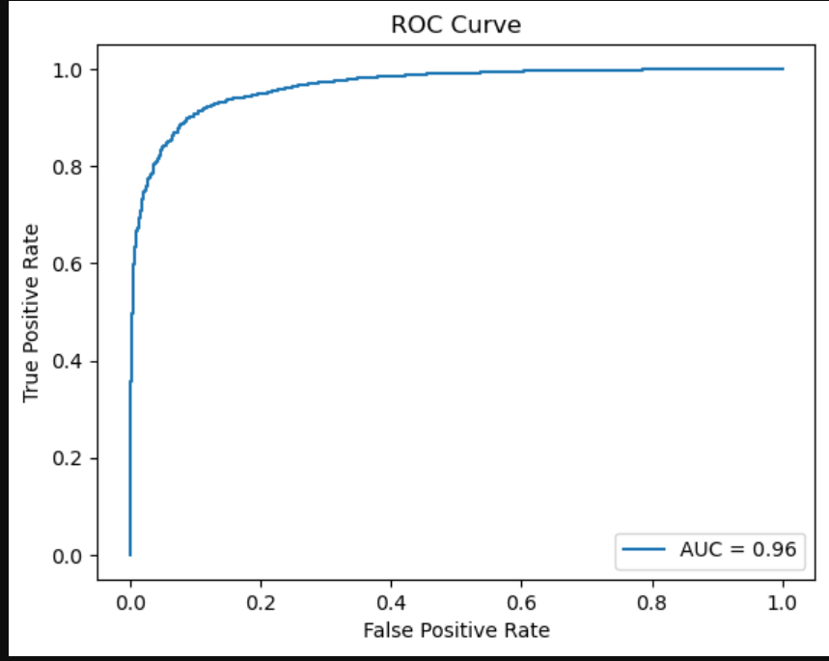
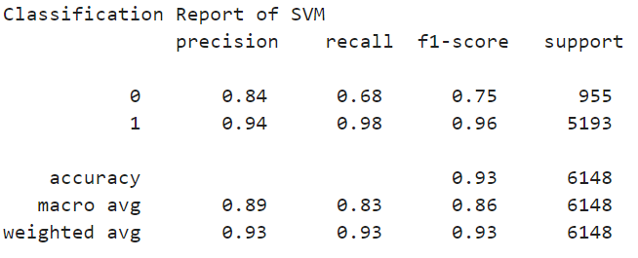
MODEL BUILDING
2. SUPPORT VECTOR MACHINES
A Support Vector Machine (SVM) is a supervised learning algorithm used for classification and regression tasks.
SVMs are effective in high-dimensional spaces and can handle both linear and non-linear data using the kernel trick, which maps the data into higher dimensions.

Slide 16
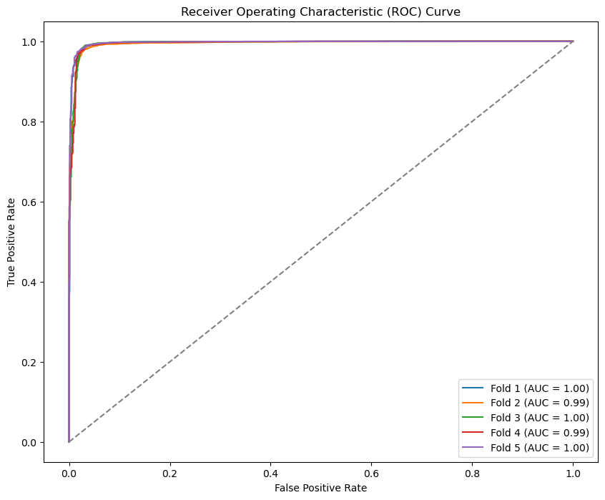
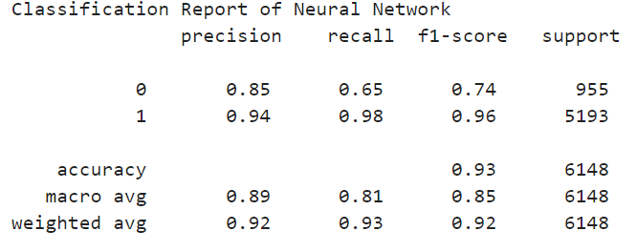
MODEL BUILDING
3. NEURAL NETWORKS
/ DEEP LEARNING
Deep Learning is a subset of machine learning that uses neural networks with many layers to model complex patterns in large datasets.
A Neural Network consists of interconnected layers of neurons that process input data through weighted connections.
The network learns by adjusting these weights during training to minimize prediction errors.

Slide 17
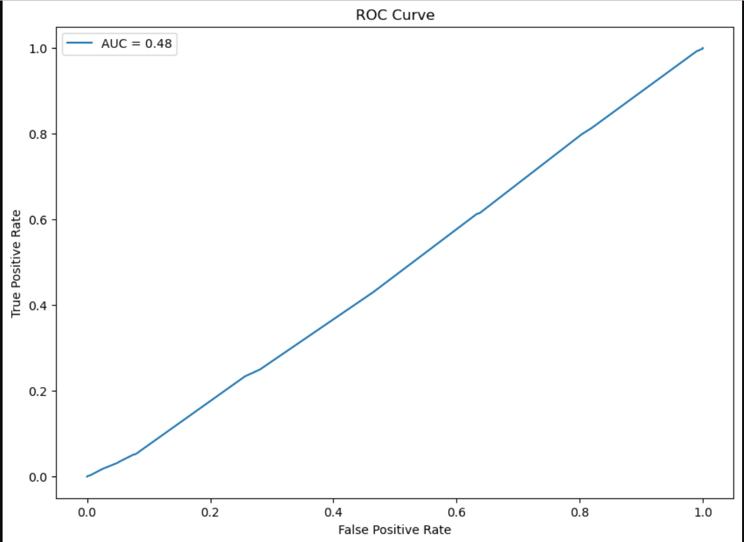
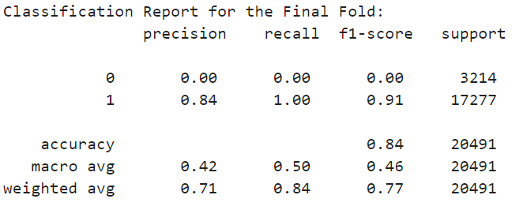
MODEL BUILDING
A Bayesian Network is a probabilistic graphical model that represents a set of variables and their conditional dependencies via a directed acyclic graph (DAG).
Each node represents a variable, and the edges represent conditional dependencies between them.
Bayesian Networks are used for reasoning under uncertainty, where they can compute the likelihood of various outcomes given certain evidence.
4. BAYESIAN NETWORKS

Slide 18
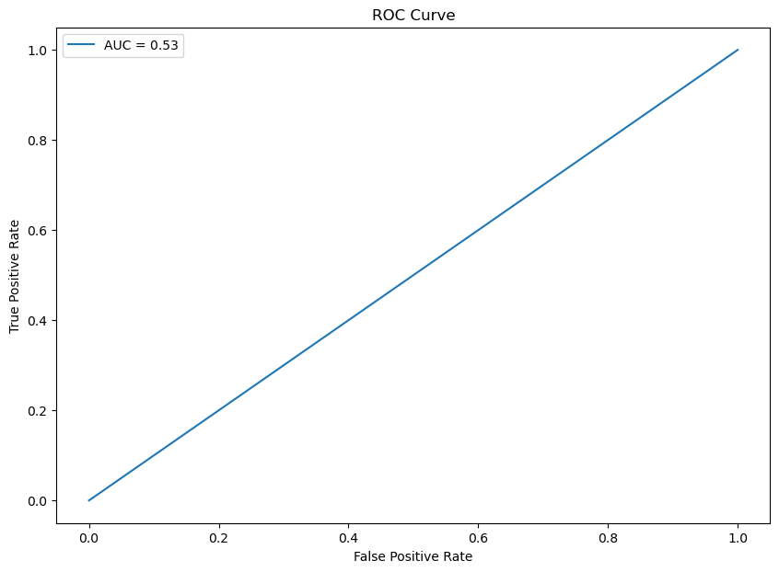
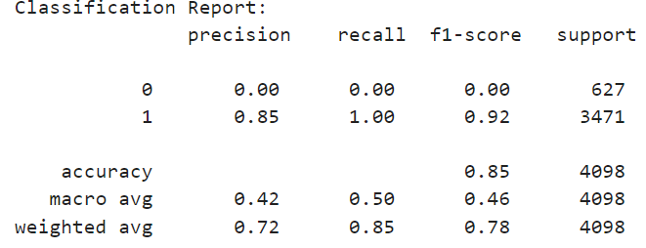
MODEL BUILDING
5. RANDOM FOREST
Multiple Trees, One Prediction: A Random Forest model creates many decision trees and combines their results to make a final prediction, making it more accurate and less likely to overfit.
Random Choices: It randomly selects different parts of the data and different features for each tree, which helps in making the model strong and reliable.

Slide 19
Selecting Best Model
Model Name | Training Accuracy | Test Accuracy | Cross Validation Score
Logistic Regression | 94.00% | 92.34% | 92.42%
Support Vector Machines | 94.81% | 92.36% | 92.00%
Neural Networks / Deep Learning | 93.66% | 92.36% | 93.00%
Bayesian Networks | 83.00% | 84.00% | 84.00%
Random Forest | 84.22% | 84.70% | 84.00%
Naïve Bayes Classifier | 84.22% | 84.70% | 50.00%

Slide 20
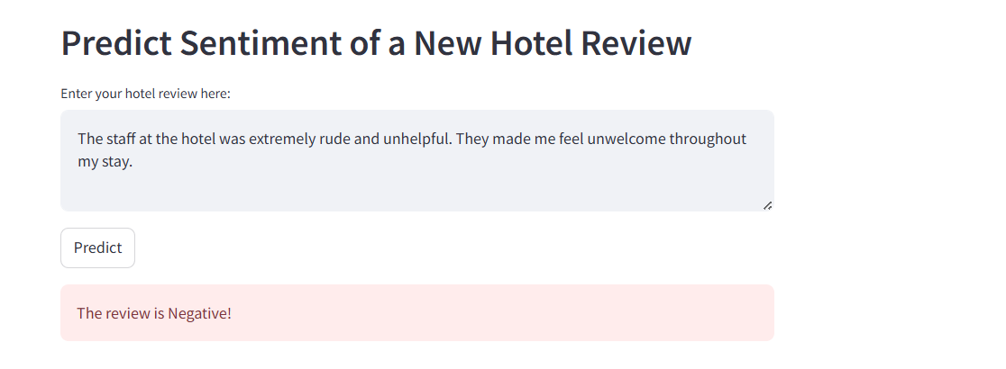
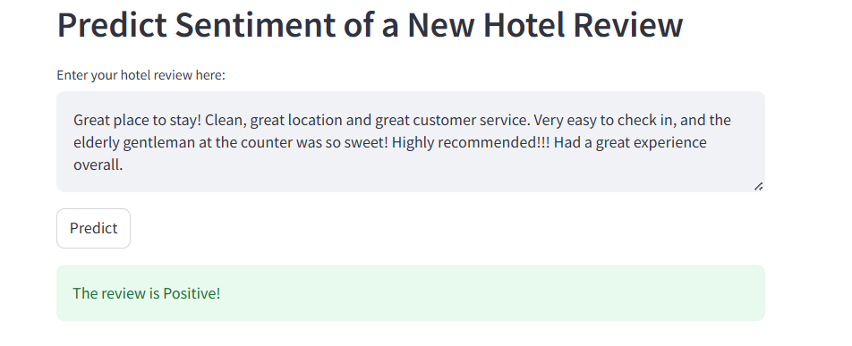
MODEL DEPLOYMENT
Model Deployment is performed using Logistic Regression by using Streamlit

Slide 21
Deploying a hotel sentiment analysis
Model Challenges
Data Quality: Handling noisy, unstructured reviews with varying languages can complicate preprocessing and analysis.
Model Generalization: Ensuring the model accurately predicts sentiment across different customer opinions and hotel contexts without overfitting.
Real-Time Processing: Balancing speed and accuracy in real-time sentiment analysis, while ensuring scalability during peak times.
Integration: Seamlessly integrating the model into existing hotel systems while managing resource constraints.
Maintenance: Regularly updating the model to prevent drift, managing costs, and ensuring compliance with data privacy regulations.

Slide 22
Conclusion
Overall Sentiment: The overall sentiment toward the hotel appears to be positive, with a majority of reviews expressing satisfaction. However, areas like parking and perceived cost may need attention if negative sentiments are prevalent in these aspects.
Model Effectiveness: The logistic regression model provided a reasonable level of accuracy, demonstrating its ability to predict the sentiment of hotel reviews effectively. However, there might be room for improvement by exploring more complex models or further refining the preprocessing steps.
The sentiment analysis of hotel reviews provides valuable insights into customer perceptions, highlights areas of strength, and identifies opportunities for improvement. With further refinement, these findings can guide both operational and strategic decisions for the hotel

